Slide 1

Number Systems
What is the Standard Base we
work with in our everyday lives?
Why do we work in that base?
© A+ Computer Science - www.apluscompsci.com

Slide 2
Common Bases
2 – 1010 0100
8 - 5672
10 – 78645
16 – ABC983EF
* 0,1,2,3,4,5,6,7,8,9,A,B,C,D,E,F represent the numbers 0 thru 15 in base 16
© A+ Computer Science - www.apluscompsci.com

Slide 3
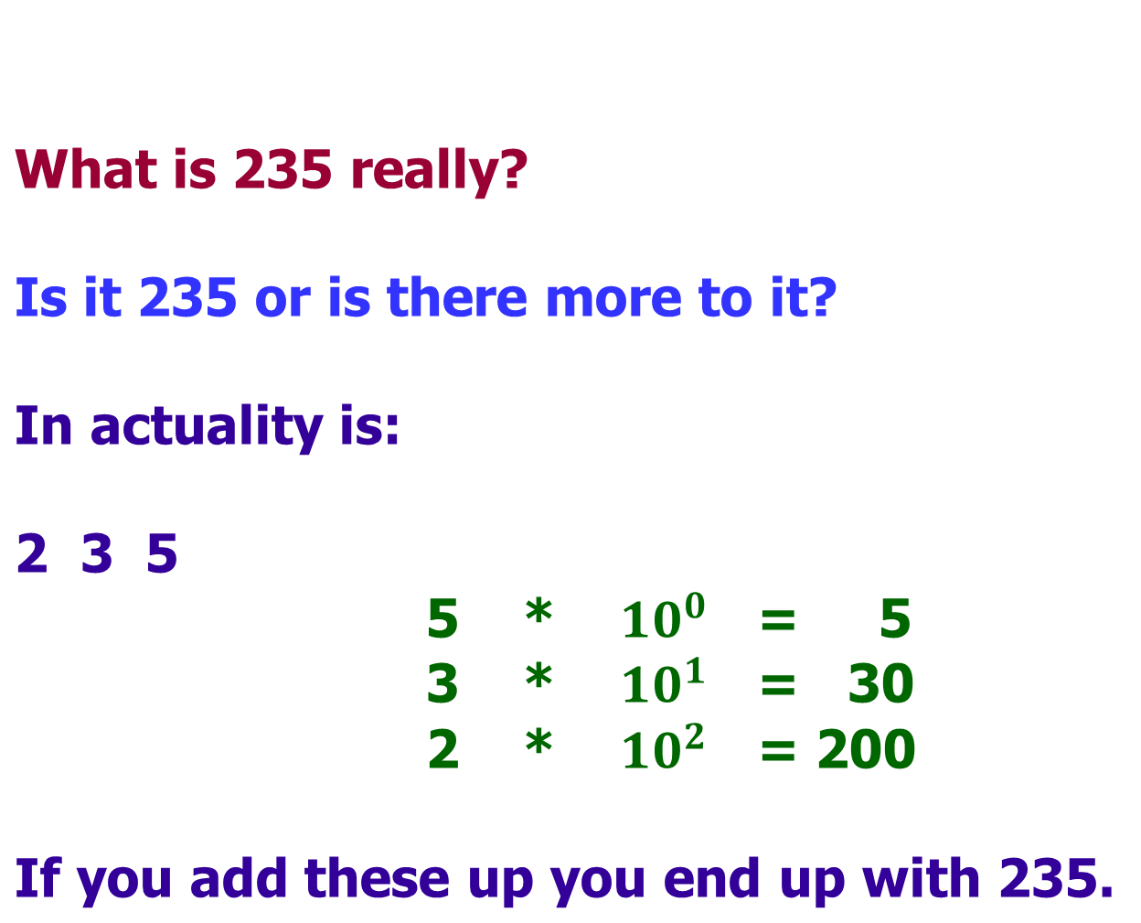

base 10
© A+ Computer Science - www.apluscompsci.com

Slide 4




base 10
What is 5402 really?
5 4 0 2
If you add these up you end up with 5402.
© A+ Computer Science - www.apluscompsci.com

Slide 5
Any base to base 10
All number systems regardless of the base work off of the same principles.
You can convert any base to base 10 by following the power system.
© A+ Computer Science - www.apluscompsci.com

Slide 6
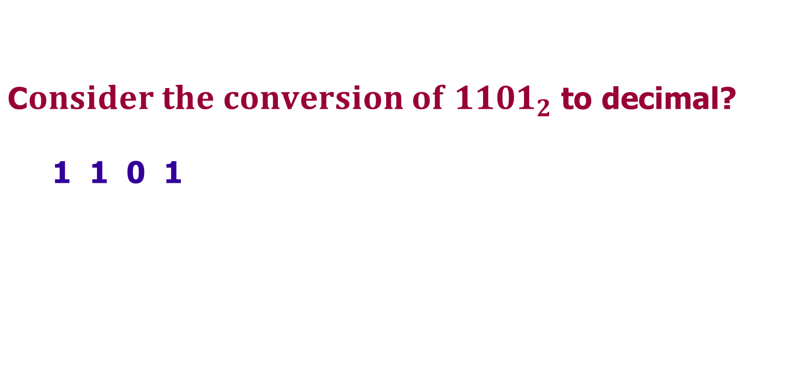




Any base to base 10
© A+ Computer Science - www.apluscompsci.com

Slide 7
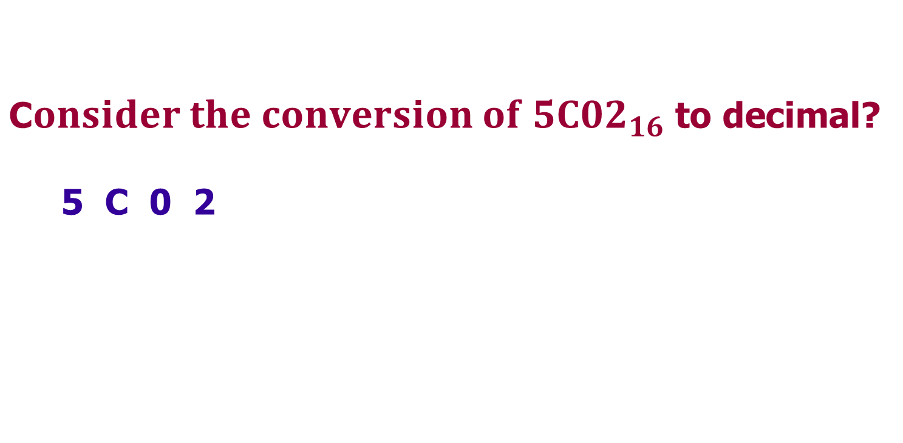




Any base to base 10
© A+ Computer Science - www.apluscompsci.com

Slide 8
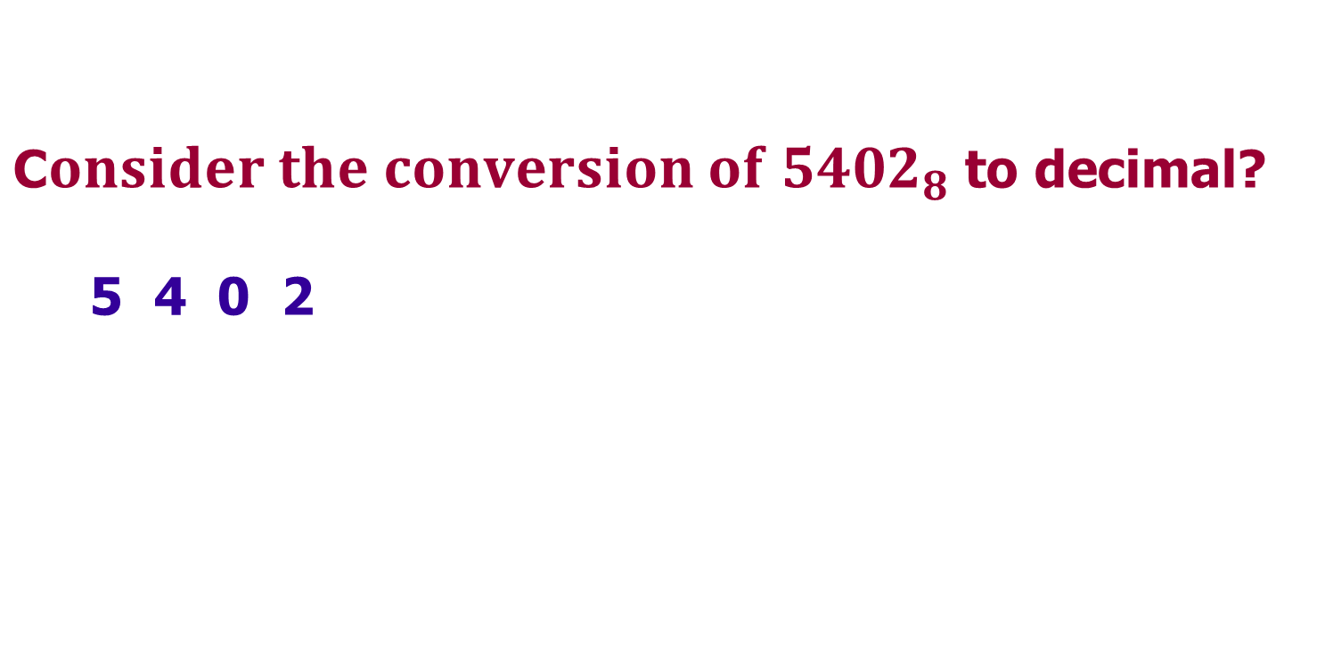




Any base to base 10
© A+ Computer Science - www.apluscompsci.com

Slide 9
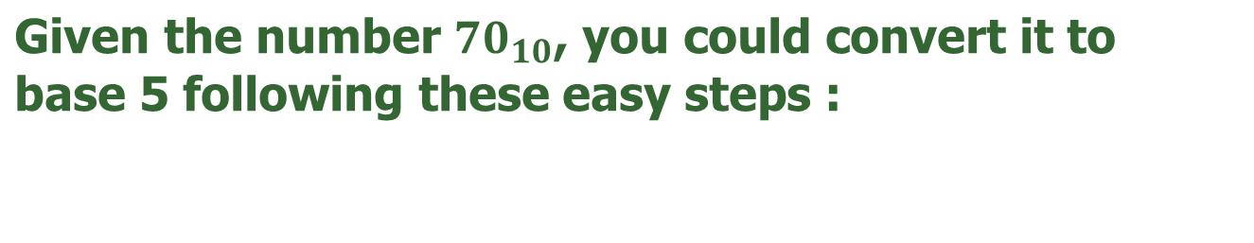
Base 10 to any base
1st divide 70 by 5: 14 R 0
2nd divide 14 by 5: 2 R 4
3rd divide 2 by 5: 0 R 2
The number 70 base 10 = 240 in base 5.
© A+ Computer Science - www.apluscompsci.com

Slide 10
Base 10 to any base
Given the base 10 number 3741, you could convert
it to base 16 following these easy steps :
1st divide 3741 by 16: 233 R 13
2nd divide 233 by 16: 14 R 9
3rd divide 14 by 16: 0 R 14
The number 3741 base 10 = E9D in base 16.
© A+ Computer Science - www.apluscompsci.com

Slide 11
Any base to any base
1st - Convert the number you want
to convert to Base 10.
2nd - Convert the Base 10 result to the
new base you want.
© A+ Computer Science - www.apluscompsci.com

Slide 12
binary - base 2
 | Binary digits
Base 10 | 8 | 4 | 2 | 1
1 | 0 | 0 | 0 | 1
2 | 0 | 0 | 1 | 0
3 | 0 | 0 | 1 | 1
4 | 0 | 1 | 0 | 0
5 | 0 | 1 | 0 | 1
6 | 0 | 1 | 1 | 0
7 | 0 | 1 | 1 | 1
8 | 1 | 0 | 0 | 0
© A+ Computer Science - www.apluscompsci.com

Slide 13
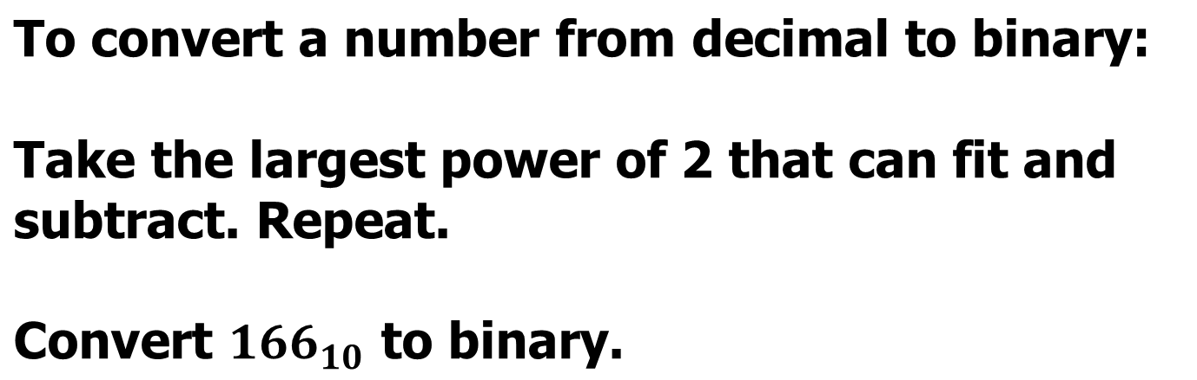
base 2 short cut
128 | 64 | 32 | 16 | 8 | 4 | 2 | 1
1 | 0 | 1 | 0 | 0 | 1 | 1 | 0
© A+ Computer Science - www.apluscompsci.com

Slide 14
base 2 to base 16
There is a direct conversion from base 2
to base 8 & base 16 without using base 10.
8 and 16 are powers of 2 so they convert
directly.
© A+ Computer Science - www.apluscompsci.com

Slide 15
base 2 to base 16
Base 2 converts directly to base 16 as each
4 bit section of base 2 equals one base 16
digit.
1111 = 15 15 is maximum single digit for 16
10 11
1010 1011 = AB in base 16
1 4 10
0001 0100 1010 = 14A in base 16
HEX
A – 10
B – 11
C – 12
D – 13
E – 14
F – 15
© A+ Computer Science - www.apluscompsci.com

Slide 16
base 2 to base 8
Base 2 converts directly to base 16 as each
3 bit section of base 2 equals one base 8
digit.
111 = 7 7 is maximum single digit for base 8
5 3
101 011 = 53 in base 8
1 2 7
001 010 111 = 127 in base 8
8
© A+ Computer Science - www.apluscompsci.com

Slide 17
java base conversion
OUTPUT
324 base 6 == 124 base10
124 base10 == 7c base16
1011010
132
5A
int base10 = Integer.parseInt("324",6);
out.print("324 base 6 == ");
out.println(base10 + " base10");
out.print("124 base10 == "); out.println(Integer.toString(base10,16)+" base16\n\n");
out.println(Integer.toBinaryString(90));
out.println(Integer.toOctalString(90));
out.println(Integer.toHexString(90).toUpperCase());
© A+ Computer Science - www.apluscompsci.com

Slide 18
java base conversion
OUTPUT
255
15
511
out.println(0xFF);
out.println(0b1111);
out.println(0777);
© A+ Computer Science - www.apluscompsci.com

